Slide 1

TECHNICAL REPORT
RESEARCH STUDY FOR THE NECESSITY OF IMPLEMENTATION OF AN AUTOMATED POINT MANAGEMENT SYSTEM IN FAST NUCES KARACHI

Slide 2






CONTRIBUTORS
Mariam Munaf
18K-0143
Sufyan Siddiqui
18K-1161
Ammarah Abid
18K-0214
Sharyar Shafi
18K-0266
Muhammad Mudassir
18K-1042

Slide 3

RESEARCH PROBLEM
Implementation of an Automated Point Management System in FAST NUCES Karachi

Slide 4

RESEARCH HYPOTHESIS
The necessity of an Automated Point Management System in FAST NUCES Karachi to track the points in real-time and to carry out the registrations through applications

Slide 5

PURPOSE
We want to know how effective this implementation will be for the University Management, Students and Staff for the everyday use of points and for the registration process at the start of each semester

Slide 6

RELEVANCE AND BENEFITS OF THE STUDY
Through this research study, we are going to draw the following conclusion
The Implementation of the Automated Point Management System in FAST NUCES Karachi will enhance the security of the passengers
It will also provide a sustainable yet reliable management of the point service from registrations till fee processing

Slide 7

ABSTRACT
OF THE TECHNICAL REPORT

Slide 8
ABSTRACT
The automation of systems has become a necessity
The need of the automation of Point Management System in FAST NUCES Karachi was the motive of the research
A survey with different questions were conducted
The responses were analyzed by exploratory data analysis using python pandas modules
Majority of the individuals supported the need for an Online Point Management System

Slide 9
ABSTRACT (Cont.)
The System should be intelligently utilizing the safety and security sensors
The System should provide the facility of E-Billing
The System should provide the facility of real-time tracking using GPS sensors
The System should provide the real-time information of Vehicle, Drivers and the Routes
The Implementation of an Intelligent Point Management System will eventually provide ease to the passengers

Slide 10

REVIEW OF LITERATURE
OF THE TECHNICAL REPORT

Slide 11
REVIEW OF LITERATURE
The point management system is required to be developed in a modular fashion [7]
The system will be obtaining the real-time information of the people in point by using RFID [1]
The system will track the points in real-time by using GPS[5,6,8,10]
There is a need of an Intelligent Transportation System[10], by using safety sensors such as Radars, LiDAR, ultrasonic and, vision-based sensors [8,10]
The management of the data from the paper-based records for the Transportation System is time-consuming [2,4]

Slide 12
REVIEW OF LITERATURE (Cont.)
The database will be structured by means of the entities [4]
The system should use technologies such as PHP, JavaScript for development [2,4]
The system should use AJAX technology for faster access to databases for a more user-responsive experience [2]
The system will provide proper e-billing facility to the users

Slide 13

INTRODUCTION
OF THE TECHNICAL REPORT

Slide 14
CURRENT SYSTEM
In the report, we focus on the current situation of the Point Management System in FAST NUCES Karachi
The current system is quite old and has problems with it
The university uses a paper-based registration system of Point service
Current fee management system operates manually

Slide 15

CURRENT SYSTEM - DISADVANTAGES
The disadvantages of the current system are
Long waiting queues for Registration
No Real-Time information of Points, Drivers and Vehicles
No GPS Tracking of Points
No Safety and Security Sensors in Points
No E-Billing facility
No Online Registration

Slide 16

AUTOMATED SYSTEM - RESOLUTION
The automated system will enhance the security of the passengers and vehicle
The automated system will provide reliable management of the point service
The automated system will use the Radars, LiDAR, ultrasonic sensors in order to provide safety
The automated system will use the geo sensors in order to provide the real-time information remotely

Slide 17

METHODOLOGY
FOR CONDUCTING RESEARCH FOR THE TECHNICAL REPORT

Slide 18
RESARCH METHODOLOGY
Questionnaire based survey was conducted
The answers of the questions were categorical variables
The questions were covering different aspects of the importance of an automated system
The answers were describing the relevance of the implementation of this automated point management system
The respondents were the undergrads of FAST NUCES Karachi

Slide 19

RESULTS
OF THE TECHNICAL REPORT

Slide 20
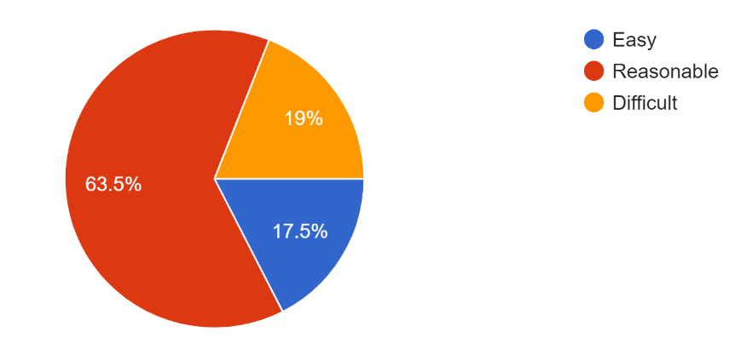
FINDINGS – COMPARISON OF POINT SERVICE
63.5% of the individuals found it reasonable to use University Point Service
19% of the individuals find it difficult to use University Point Service
17.5% of the total individuals who took part in the survey it is declared easy

Slide 21
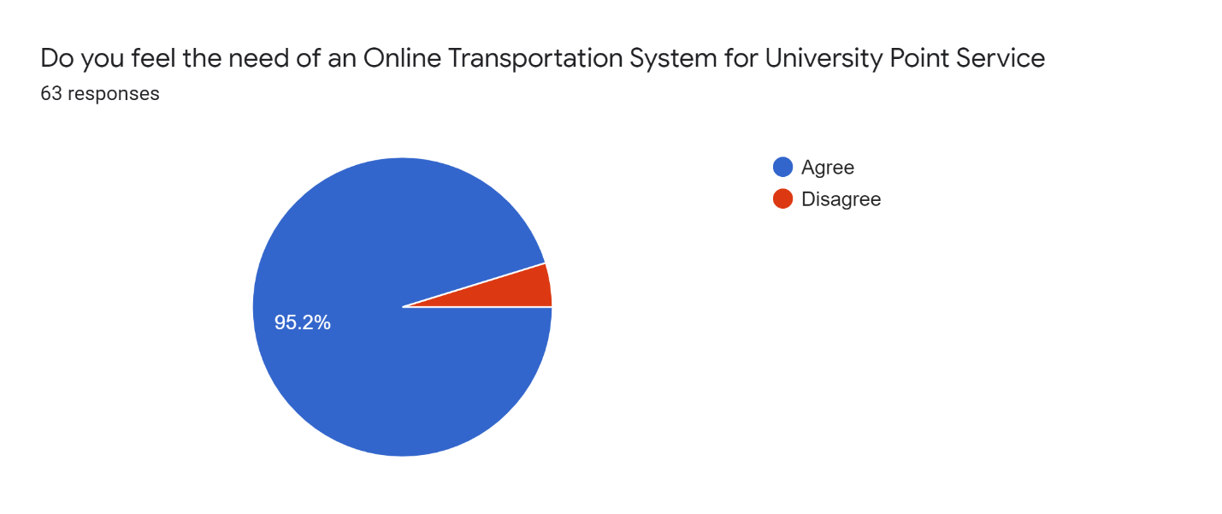
FINDINGS – NEED OF AN ONLINE POINT MANAGEMENT SYSTEM
95.2% of the total individuals agreed to it making it quite accurate that Automation is necessary
The small number of people found themselves satisfied with the current paper-based system

Slide 22
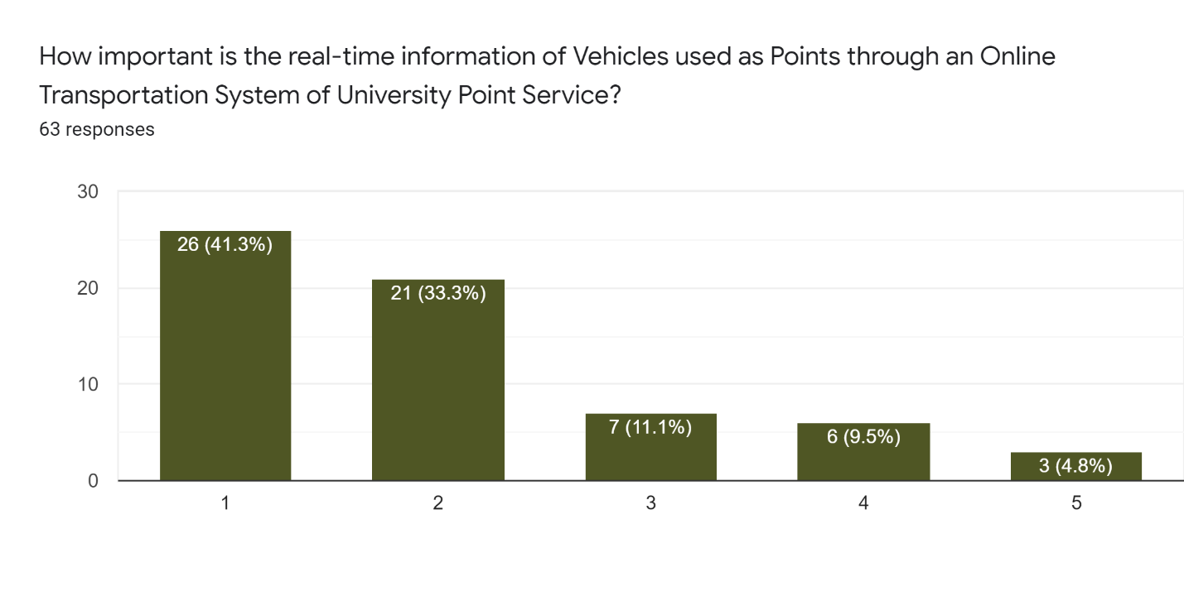
FINDINGS - Need of real-time information of Routes of Points
The majority of the individuals found it necessary to have real-time information of the daily routes
Only 3 individuals found it unnecessary to have this information

Slide 23
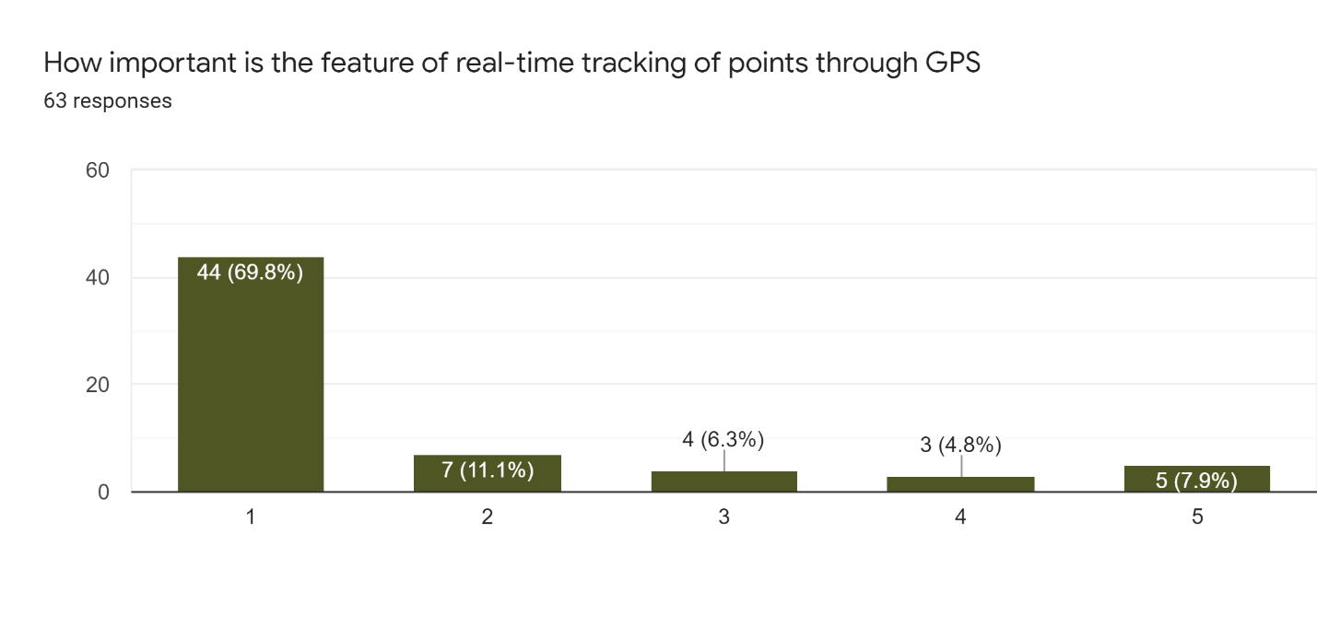
FINDINGS - Need of real-time information of Drivers
The majority of the individuals marked it extremely important to have the information of driver(s) they are travelling with to be more secure and safe

Slide 24
FINDINGS - Need of real-time tracking of Points
69.8% of individuals found it important to have the real-time location information of Points through GPS Sensor

Slide 25
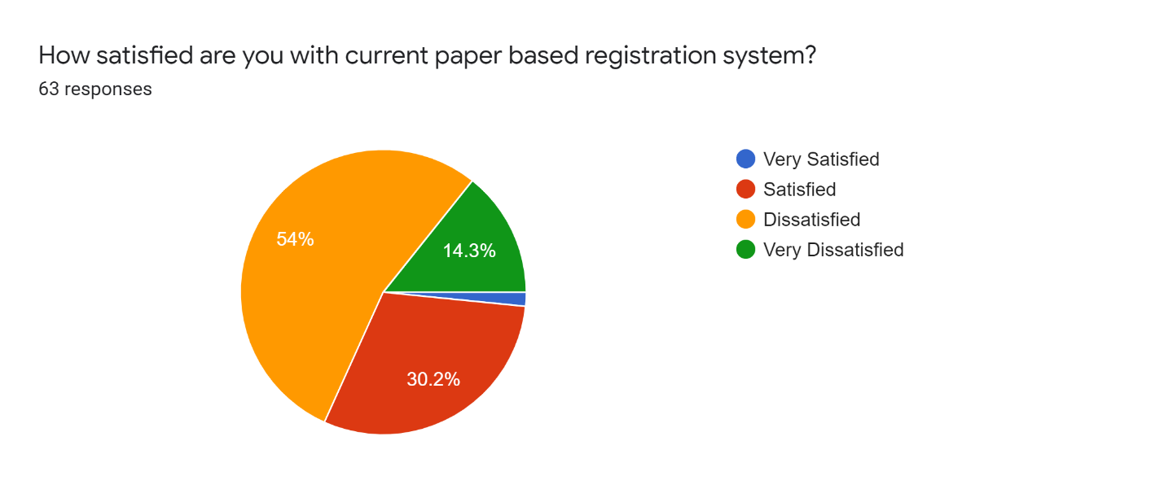
FINDINGS - Satisfaction with the current paper-based registration system
Majority of the individuals are dissatisfied with the current paper-based registration system of points
14.3% were very dissatisfied with the current paper-based registration system of points

Slide 26
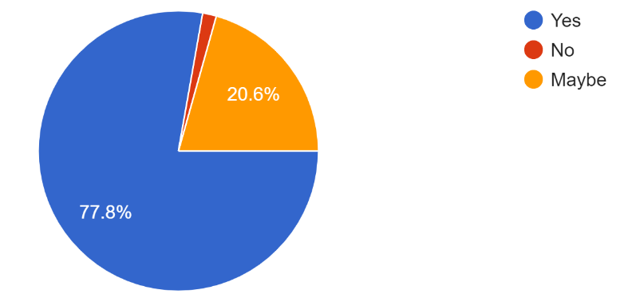
FINDINGS - Need of Online Registration
A large number of participants with a percentage of 77.8% indicated that they are in utmost need of an Online Registration System

Slide 27
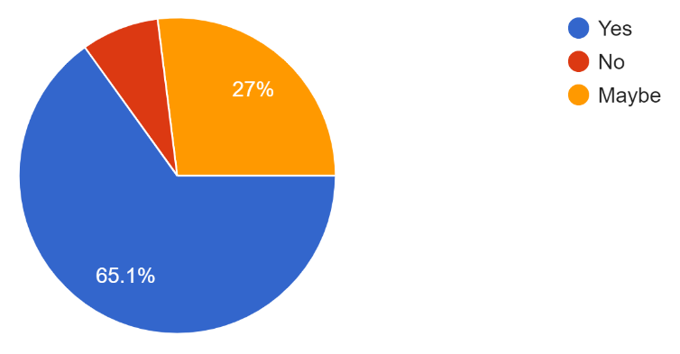
FINDINGS - Need of E-Billing System
65.1% of the individuals supported the idea of e-billing facility
27% of individuals were not sure about the e-billing facility in automation of Point Management System

Slide 28
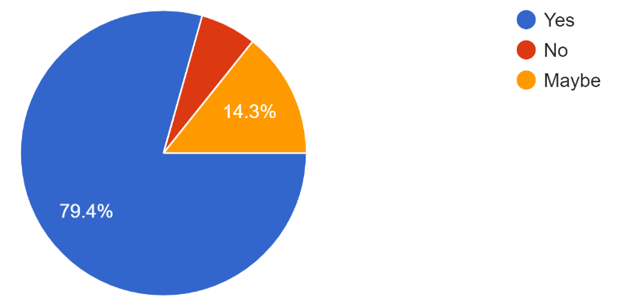
FINDINGS - Need of Intelligent Safety and Security Sensors
The idea of safety and security sensors was supported by 79.4% of the individuals
14.3% of the individuals were unsure about the idea of safety and security sensors

Slide 29

CONCLUSION
OF THE TECHNICAL REPORT

Slide 30

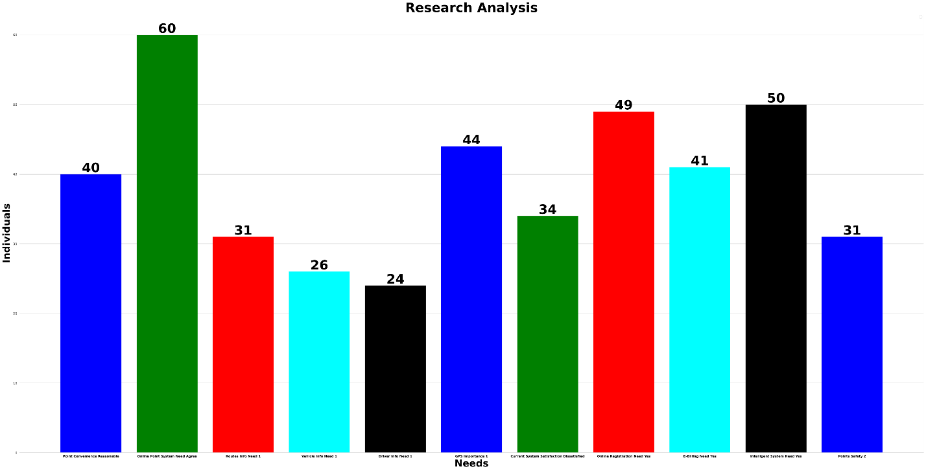
CONCLUSION - EXPLORATORY DATA ANALYSIS

Slide 31
CONCLUSION - EXPLORATORY DATA ANALYSIS
90% supported the need of Online Point System in FAST Karachi
83% of the population supported the implementation of an Intelligent System of Point Service
81.6% of the population supported the facility of an Online Registration of Point Service
73% of the population found the tracking of points as an extremely important feature
68% of the population found the facility of an E-Billing extremely important

Slide 32
CONCLUSION - EXPLORATORY DATA ANALYSIS
66% of the population found the facility of Point reasonable as compare to Public Transport
56% of the individuals are dissatisfied with the current paper-based registration system
51.6% of the individuals found it extremely important to have first-hand information remotely of the routes on which the points will go respectively
43% of the population found it extremely important to have information about the point in which they are travelling
40% of the population found it extremely important to have information about the driver they are travelling with

Slide 33

RECOMMENDATIONS
OF THE TECHNICAL REPORT BASED UPON THE CONCLUSION

Slide 34
RECOMMENDATIONS
The Point Management System should be an Online System so that it can be accessed remotely irrespective of the place
The System should be an Intelligent System utilizing Safety and Security Sensors to somehow avoid fatal accidents as well as uncertain situations to ensure the safety of passengers
The System should be having a facility of Online Registrations for the individuals who want to avail of the Point Service to avoid long queues and manual registrations on the registration desk

Slide 35
RECOMMENDATIONS
The Points should have GPS sensors to provide real-time information to the individuals who use this service as well as to the administration of the University for safety purposes
The System should have the functionality of E-Billing to provide ease to the registered individuals through Online Funds Transfer Services so that they can pay their Point Fee online without going through the hassle of Pay Orders and Cash Payments
The Point Management System should provide the registered users with the real-time information of the Routes their Points go to, the Point Drivers and, of the vehicles being used as Points to be aware of the sudden changes of drivers, vehicles and routes

Slide 36

IN A NUTSHELL
Point Management System built following the above-stated aspects will most likely prove itself to be a worthy one and to enhance current services while providing ease to the Students, Veterans, Teaching and Non-Teaching Staff who use University Point Services as well as to the Admin Panel who administer the Point Management in FAST NUCES Karachi.

Slide 37


